Slide 1
The Sophists Dr. Stephanie Spoto sspoto@mpc.edu Monterey Peninsula College
Gentrain
4 October 2018

Slide 2
What is sophistry?

Slide 3
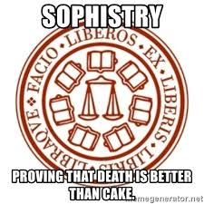
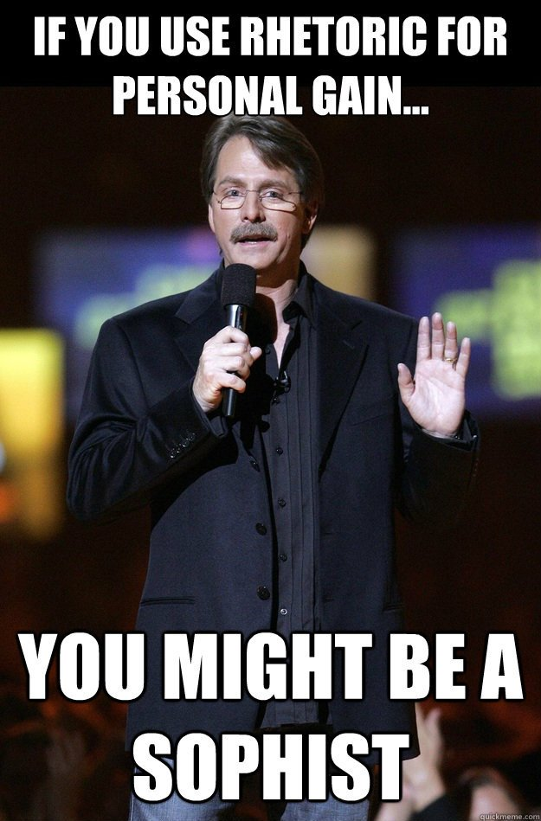
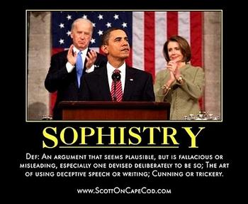

Slide 4
The backlash against reason
Major pre-Socratic schools: Milesian, Atomist, etc. espoused reason and science as primary method of inquiry
Universe was ordered and unified → can be known through rational inquiry
Skeptical movement developed in the Sophists, confronted this rational movement in the 5th century BCE

Slide 5
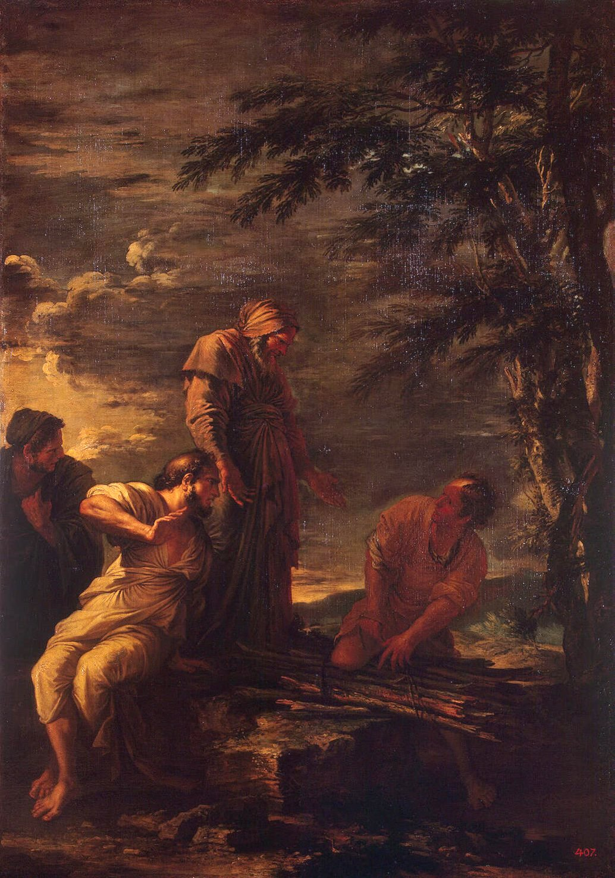
Foreigners and Charlatans!
Term “sophist” originally meant “professor”
Have come to be hated by philosophers → truth, rhetoric; wisdom, debate
Henry Sidgwick (1872) argued that the sophists were:
a set of charlatans who appeared in Greece in the fifth century, and earned an ample livelihood by imposing on public credulity: professing to teach virtue, they really taught the art of fallacious discourse, and meanwhile propagated immoral practical doctrines...they were there met and overthrown by Socrates, who exposed the hollowness of their rhetoric, and triumphantly defended sound ethical principles against their pernicious sophistries
Democritus (center) and Protagoras (right)
17th-century painting by Salvator Rosa
in Hermitage Museum

Slide 6
Dangerous, potentially soul-imperiling
As Robert George (b. 1955) of Princeton observes:
''The explicit point of the dialogue is to demonstrate the superiority of philosophy (the quest for wisdom and truth) to rhetoric (the art of persuasion in the cause of victory). At a deeper level, it teaches that the worldly honors that one may win by being a good speaker can all too easily erode one's devotion to truth -- a devotion that is critical to our integrity as persons. So rhetorical skills are dangerous, potentially soul-imperiling, gifts.''

Slide 7
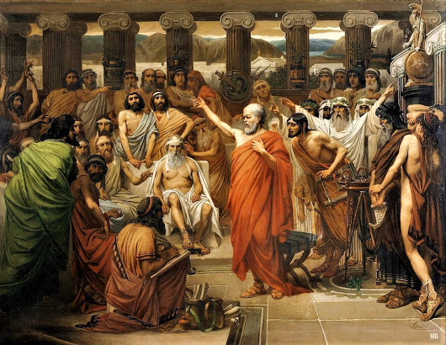
The profession of professor and rhetor
Sophists made a living teaching young men things that it was thought would be useful to them in daily and practical life
No public education → philosophers generally tutored the wealthy
Coached and wrote speeches for the plaintiff and the accused during trials
Judges were selected from the civilian public – more like today’s jury → less specific training than today’s judges and potentially open to more persuasion
Success or failure depended on ability to persuade jury/judges through appealing to popular prejudices
Each (plaintiff and accused) had to deliver for themselves, but many paid rhetoricians to write the speeches for them, or to coach them
Louis J. Lebrun (b. 1844), 'Socrates speaks

Slide 8
Why so hated?
Many of the things accused of don’t have much standing today:
Foreigners
Taking pay for teaching
Not that they taught for money, but that they would teach anyone for money
Led to Socrates (in Xenophon’s account) to accuse them of being prostitutes → aristocratic mindset: only those who deserve to be taught should be taught
Sophists countered this view, claiming that training and practice just as important as human nature
Reveals tension around egalitarianism vs. elitism; cosmopolitanism vs. tribalism

Slide 9
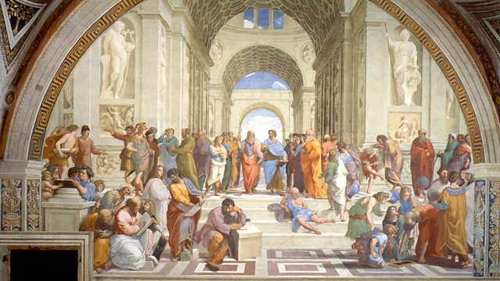
Sophism and populism Michael Gagarin notes in Antiphon the Athenian:
The Sophists were just as critical, both of earlier writers, especially the poets, and of each other. They also criticize speciﬁc institutions, such as the legal system. But unlike Heraclitus and other Presocratics, they do not criticize or belittle people in general for lacking intelligence or for having no comprehension. On the contrary, in the Protagoras, Protagoras defends the practice of allowing everyone a say on matters of public concern. Not all Sophists would go so far, but in contrast to the explicit elitism of the Presocratics, the Sophists tend to be more populist, criticizing primarily the views of traditional authorities, not those of ordinary people.

Slide 10
Truth?
Though they were populists, this was not the primary challenge articulated against the Sophists
Philosophers concerned that they practiced eristics (debate) with no concern for truth
However, they wrote often on truth, but these works do not survive (both Protagoras and Antiphon)
What survives presents complex view on truth and views of the truth
Plato attacks the Sophists often in his work:
“Protagoras’s Truth is true to nobody” (Theaetetus I7Ic)
Rhetoric is false (Gorgias 458e— 459C, etc.)
More concerned with probability than truth ((Phaedrus 267a, 272d—273c)
What survives of their accounts of truth presents it as a value and even a goal, while recognizing it is primarily a judgement rather than a fact

Slide 11
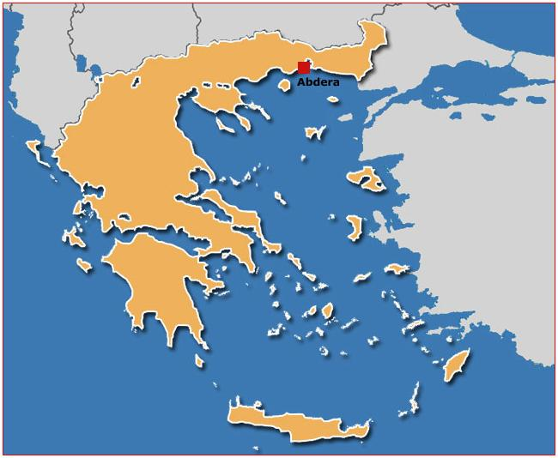
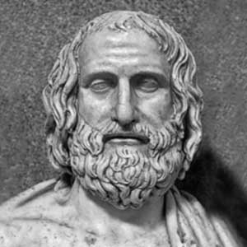
Man is the measure of things
Protagoras (b. c500 BCE) in Abdera
Famous for doctrine: “Man is the measure of all things, of things that are that they are, and things that are not what they are not”
Interpretation: each man is the measure of all things, and when there are differences in judgement, there is no way of telling objective truth
Skeptical → deception of senses

Slide 12
Sophists and debate
Protagoras traveled around Greece and lectured
Most philosophical thinkers would found schools, form a brotherhood and a kind of monastic life, have a hidden knowledge for initiates
Not true of Sophists → would argue any opinion, without necessarily advocating any of the conclusions they drew
For those to whom philosophy was a way of life, almost a religion, this seemed immoral

Slide 13
Skepticism
Pursuit of truth must ignore morality → got given that the truth will edify or improve society
Sophists prepared to follow an argument wherever it lead → often it was to skepticism
Most of the arguments of the Sophists come through the lens of those who hated them
Sophist Gorgias said that nothing exists, and if something did exist it is unknowable → even if knowable to one man, can never communicate it to others
We do not know of his actual arguments, but must have had a logical force behind them that caused the philosophers to take refuge in edification (morality)
Plato would often judge arguments by their moral impact and social consequences

Slide 14
The Capital T Truth?
Sophists could represent relativism, but could also represent pluralism
If the Truth is OUT THERE, then rhetoric and philosophy perhaps stand opposed
However, if truth is complicated (even plural?), then to find it we must hear the unhearable and see the unseeable, then rhetoric indispensable part of aisthesis and philosophy

